Slide 1
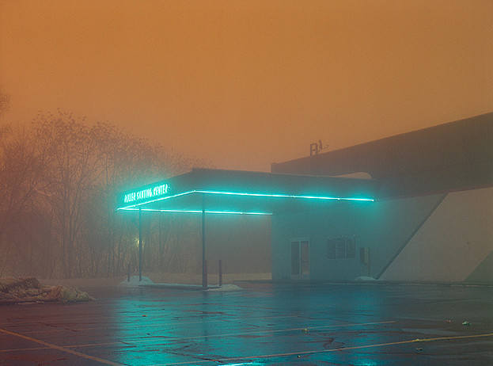


Freifunk for Things
LoRaWAN & The Things Network
Freifunk Assembly, 33c3 Day2 -18:30
CC BY-SA 4,0

Slide 2
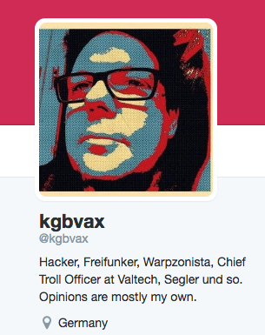
Hello.

Slide 3
Freifunk Mission
„Freifunk steht für freie Kommunikation in digitalen Datennetzen
Wir verstehen frei als öffentlich zugänglich, nicht kommerziell, im Besitz der Gemeinschaft und unzensiert.“

Slide 4
LPWAN?
Low Power Wide Area Network
Notes:
Low-Bandwith communication for autonomous devices
Low Energy Consumption
Batteries, Solar Cells, Energy Harvesting - Up to 10 years on a single battery
Long Range
kilometers!
means low infrastructure costs - “into the basement”
Low Cost & Simple
“Secure”
Non goal: High data rate

Slide 5
Goals
Low-Bandwith communication for autonomous devices
Low Energy Consumption
Batteries, Solar Cells, Energy Harvesting - Up to 10 years on a single battery
Long Range
kilometers! -> means low infrastructure costs - “into the basement”
Low Cost & Simple
“Secure”
Non goal: High data rate

Slide 6
IoT Applications
Yada yada: Wearables, Quantified Self, Smart* Home, Connected Car, “Locks”
Field is much wider, still emerging. #Neuland
I am interested in: Smart* Foo The world around us - based on Open Data. Let’s take stock!
*with variable definitions of „Smart“

Slide 7
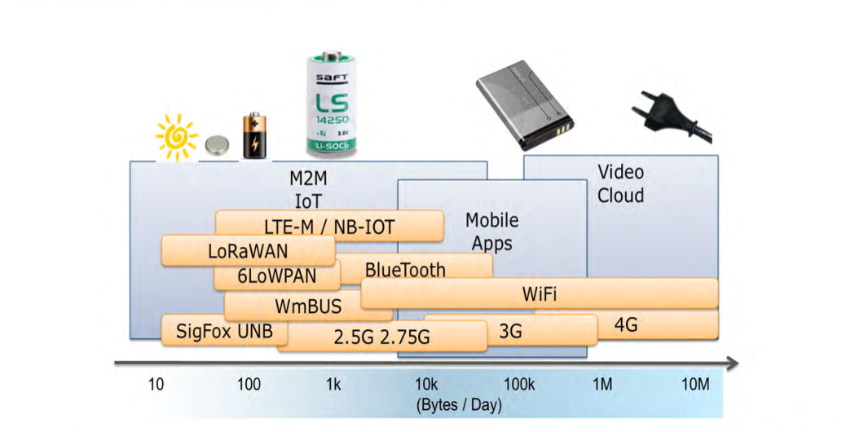
LPWAN & others
Quelle: F.Vannel, „Communications pour l’internet des objets“

Slide 8
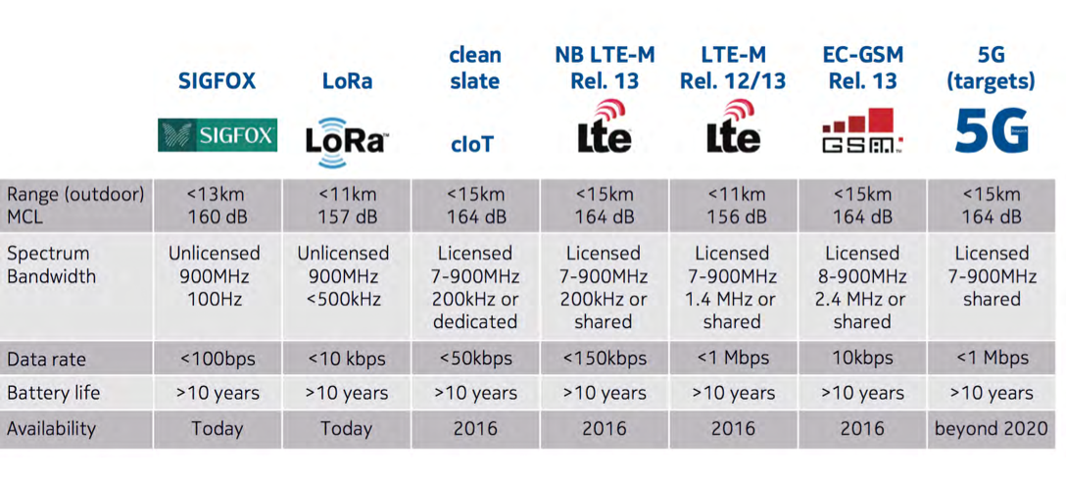
LPWAN ‘Standards’
(incomplete list)
Quelle: Nokia

Slide 9
LPWAN is a compromise
Many restrictions
Receiver is mostly ‘off’
Rate limiting

Slide 10
LoRaWAN Technology

Slide 11
LoRa Radio
LoRa(tm) - a modulation
Unlicensed but regulated ISM bands
EU: 868 Mhz, US 913Mhz, 430 China,Japan
Chirp Spread Spectrum Modulation
Demodulate ~20dBm below noise floor

Slide 12
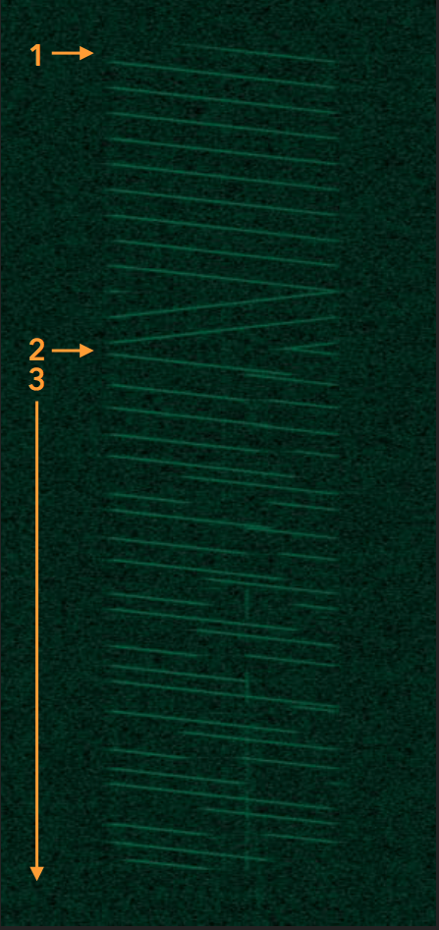
LoRa Chirp Spread Spectrum
See “Decoding the LoRa Phy” - Matt Knight
33C3, Day 3, Hall 6, 18:30
Notes:
Spectacular link budget: demodulate at -134dBm

Slide 13
868 EU ISM Regulation
863-870 Mhz:
<1% duty cycle
25mW
Downlink channel (869,4-869,65)
<10%
500mW
863-865, 868,7-869,2: <0,1%

Slide 14
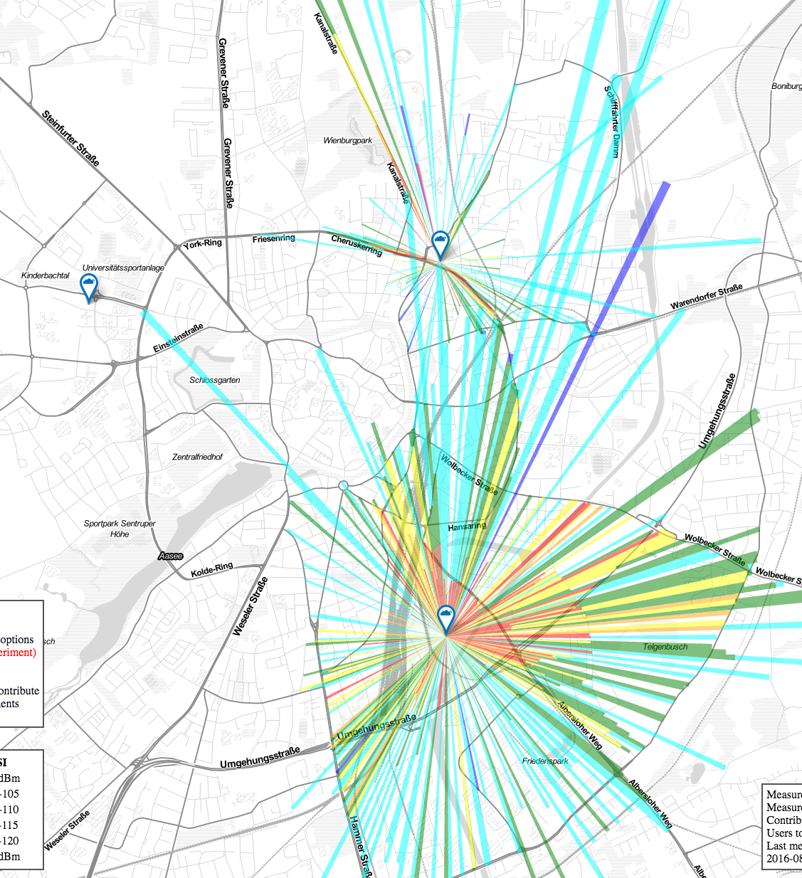
Long Rang
Long Range
ttnmapper.org

Slide 15
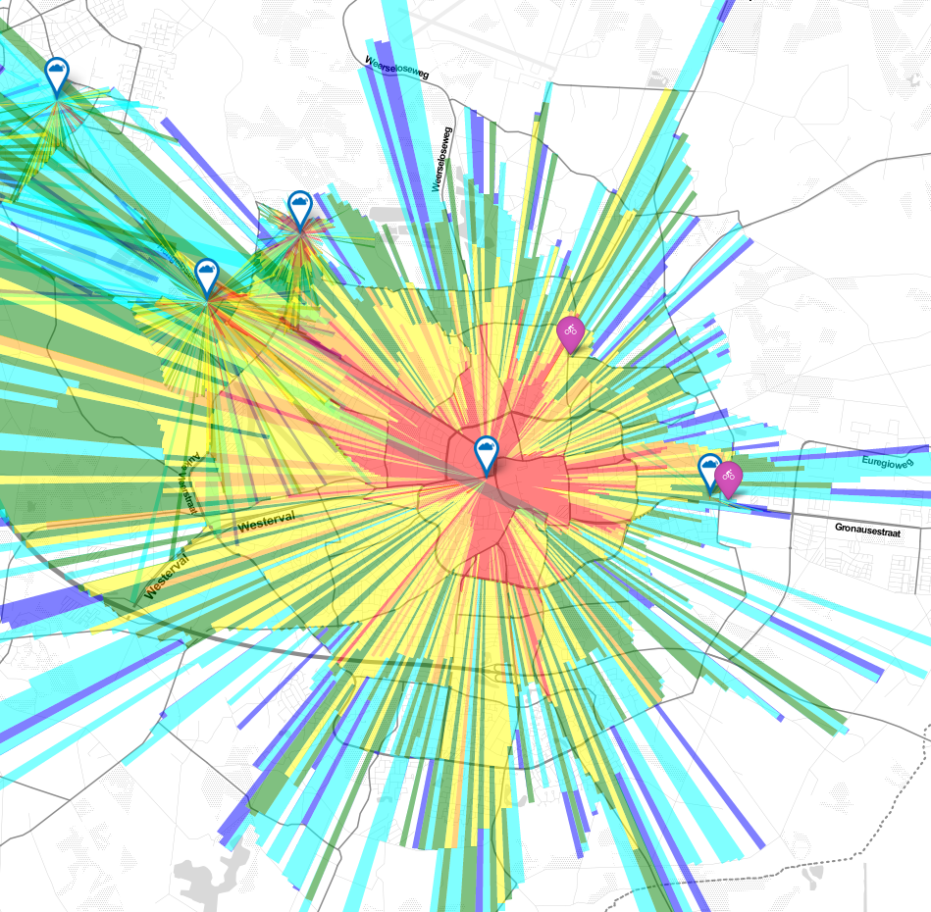
Enschede
Friends
At
Enschede
ttnmapper.org

Slide 16
Range
~2-3 km urban
>10 km rural
> 100 km at freak conditions
Factors
Line Of Sight (LOS)
Elevation of Gateways
Elevation of Node
Be careful with nodes close to ground.

Slide 17

LoRaWAN
LoRa® = Radio
LoRaWAN = Network
LoRa is SEMTECH proprietary LoRaWAN ist open specification
https://www.lora-alliance.org/

Slide 18
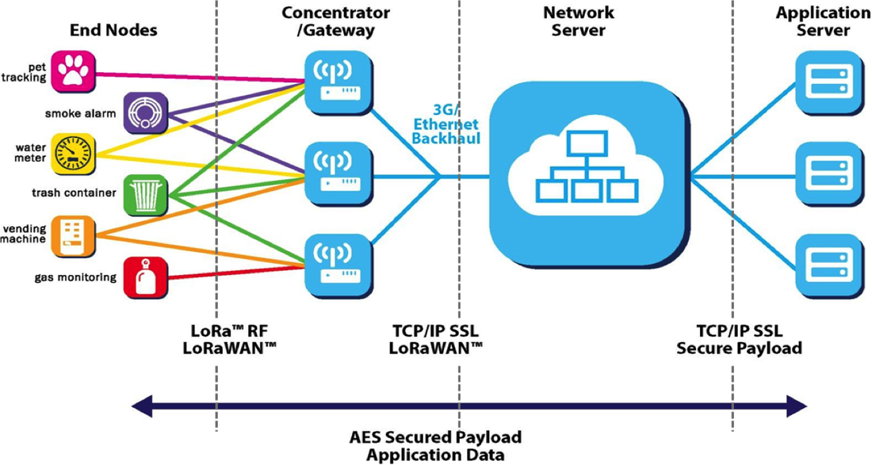
LoRaWAN Structure
Notes:
LoRa® = Radio
LoRaWAN = Network
LoRa is SEMTECH proprietary LoRaWAN ist open specification

Slide 19
Basics
Gateways receive on all (8) channels (concurrently)
No overhead for coordination since there is none - “ALOHA network”
Gateways forward packets to network
Network is “just software”

Slide 20
Device Classes
Class A
Node transmits at will and waits a short time for a response
No data reception outside ^^ recieve window
Class B
Node listens at set intervals
Synchronised via time beacons transmitted by Gateways
Requires very precise time (µS) at Gateway and Node
Class C
Node is constantly listening
High energy consumption

Slide 21
Power Consumption
e.g. MICROCHIP RN2483 (@3,3V)
Transmit: 17-40 mA
Receive: 14mA
Idle: 2,8mA
Deep Sleep: 9µA <<< Most of the time

Slide 22
Payload
Captain Obvious: LoRaWAN is not TCP/IP
51..222 byte payload per message
Depending on data rate

Slide 23
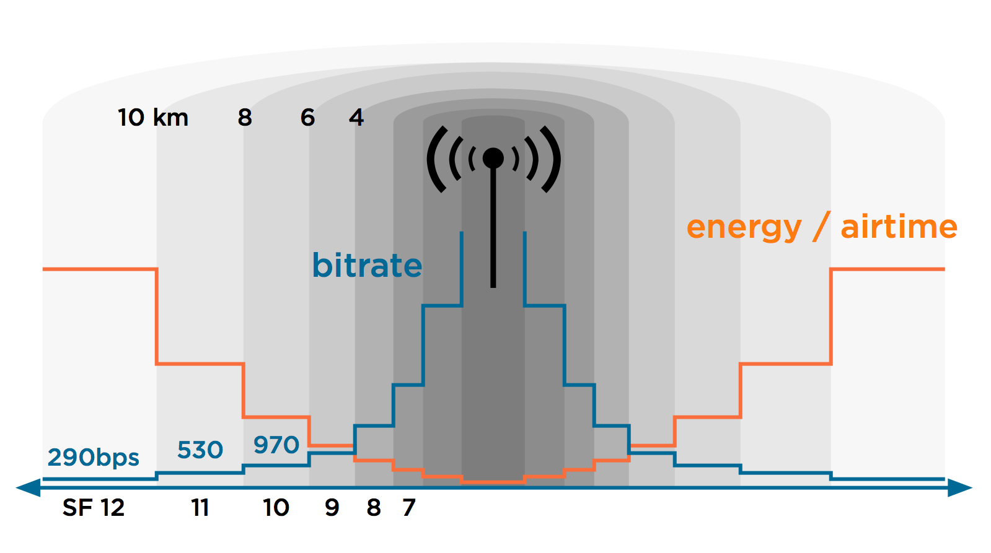
Adaptive Data Rate

Slide 24
Why not a mesh?
Mesh requires too much energy
Receiver needs to listen
Active Link-State protocols require regular transmissions
Mesh collides with duty-cycle regulation

Slide 25
Security
Mandatory AES128 crypto
Shared Secret between node and application
The verdict about the quality of this encryption (AES modes) is still out

Slide 26
LoRaWAN Deployments
KPN, Netherlands
Proximus, Belgium
SK Telecom, Korea
Bouygues Telecom, France
Swisscom, Switzerland
telent, Germany

Slide 27
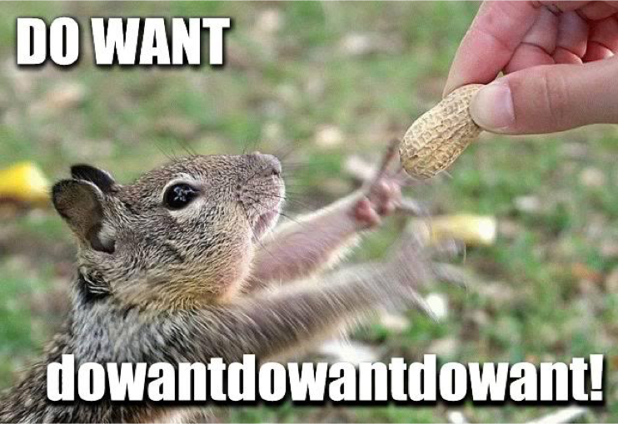

Slide 28
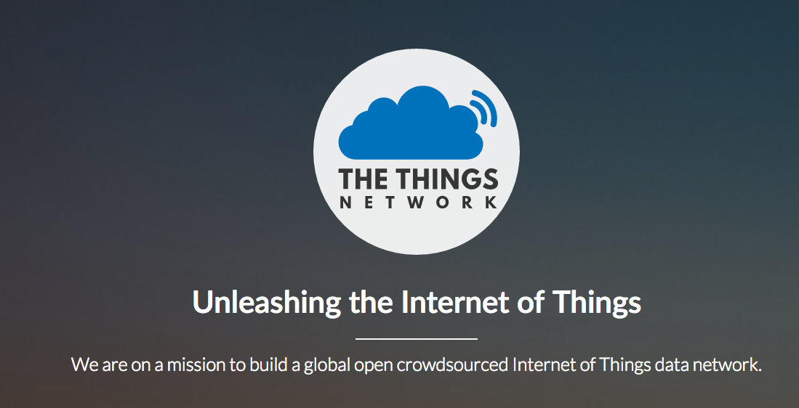
The Things Network

Slide 29
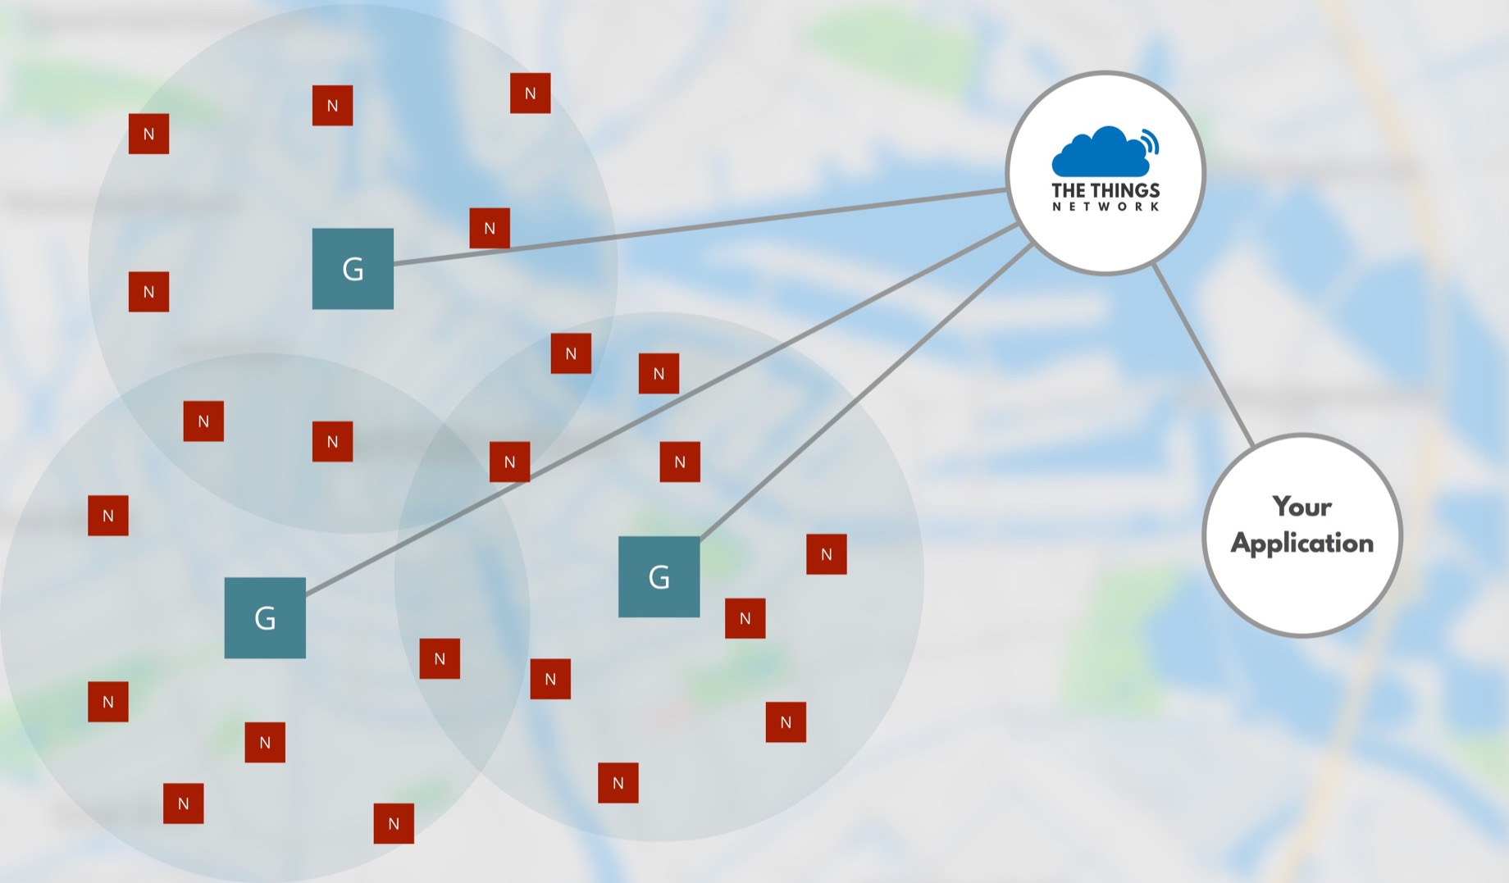

Slide 30
The Things Network
Crowd Sourced Network
Gateways owned by Individuals (swarm) & Organisations
Open Source LoRaWAN Network Stack
Run by „The Things Network Foundation“
Free as in free & free as in beer

Slide 31
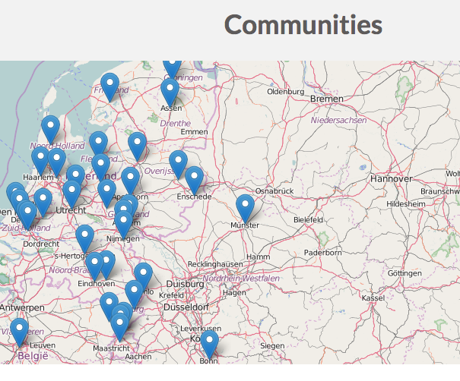
Communites

Slide 32
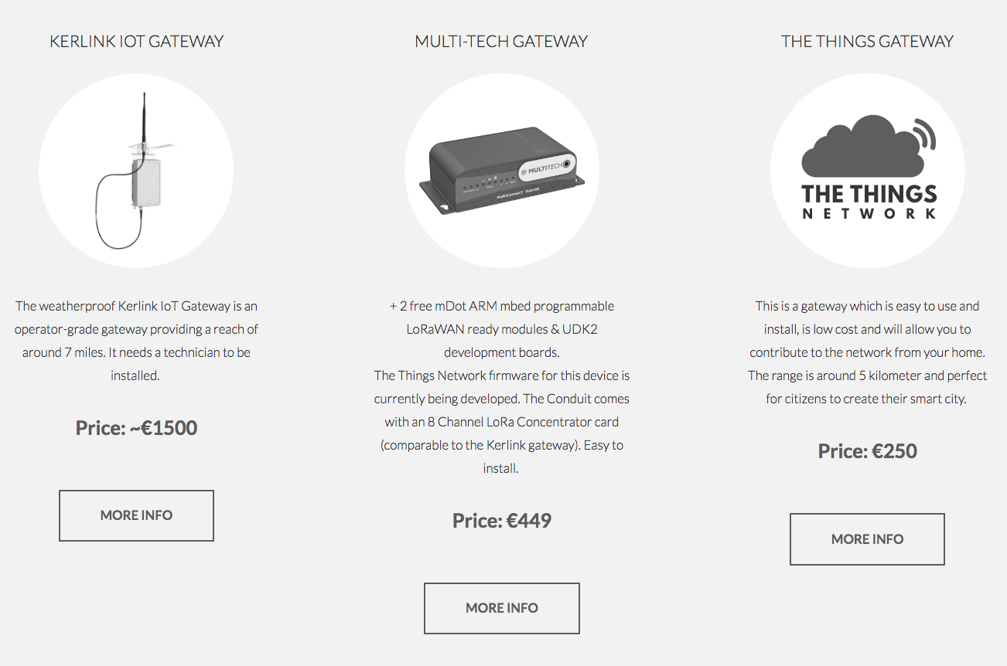
Buy…
Kaufenoder bauen

Slide 33
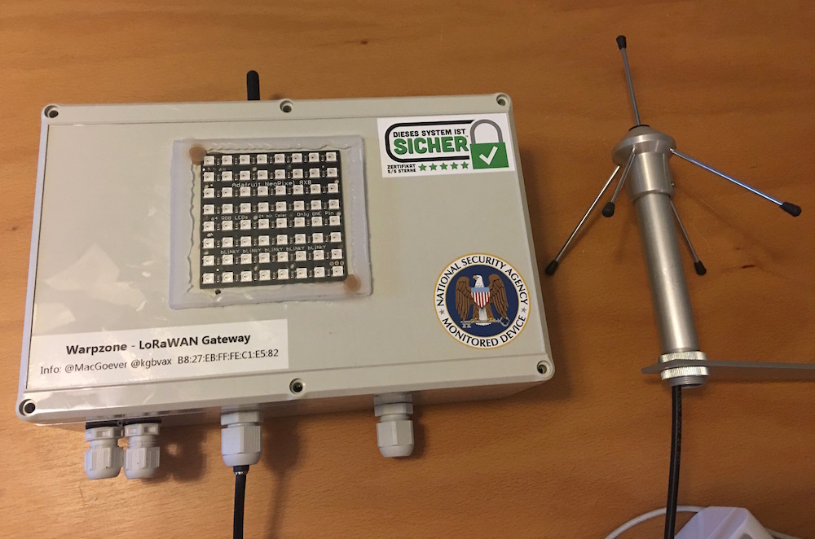
Or build your own
IMST LoRaWAN Concentrator: ~180€
Raspberry Pi + Open Source
#win
https://github.com/ttn-zh/ic880a-gateway/wiki

Slide 34
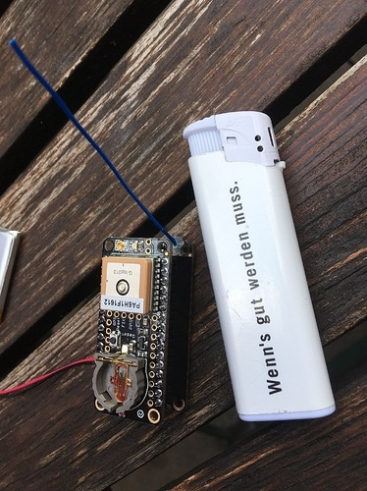
Nodes
Build your own(RN2483, HopeRF) + MCU (e.g. Arduino)
Buy
Sodaq Autonomo / One
Moteino
LoPy
Adafruit Feather LoRa
Lots of stuff in development
Prices are coming down

Slide 35
TTN API
Basic interface between app and network is MQTT
RESTful management API
Web: https://staging.thethingsnetwork.org

Slide 36
TTN in node.js
var ttn = require('ttn');
var appEUI = '70B3D57ED000033E';
var accessKey = '********************************************';
var client = new ttn.Client('staging.thethingsnetwork.org', appEUI, accessKey);
client.on('uplink', function (msg) {
console.log('Received message', msg);
});
client.on('activation', function (msg) {
console.log('Device activated:', msg.devEUI);
});

Slide 37
TTN Fair Use Policy
Golden rule: 30 seconds air-time per device per day
For 10 bytes of payload, this translates in (approx.):
20 messages per day at SF12
500 messages per day at SF7
This allows for >1000 nodes per gateway

Slide 38
Freifunk & TTN
Create an IoT network like LoRaWAN available to everyone everywhere
Own. The. Network.
Create a “canvas” Let’s play!
Open Data by default
Freifunk as Backhaul Network

Slide 39
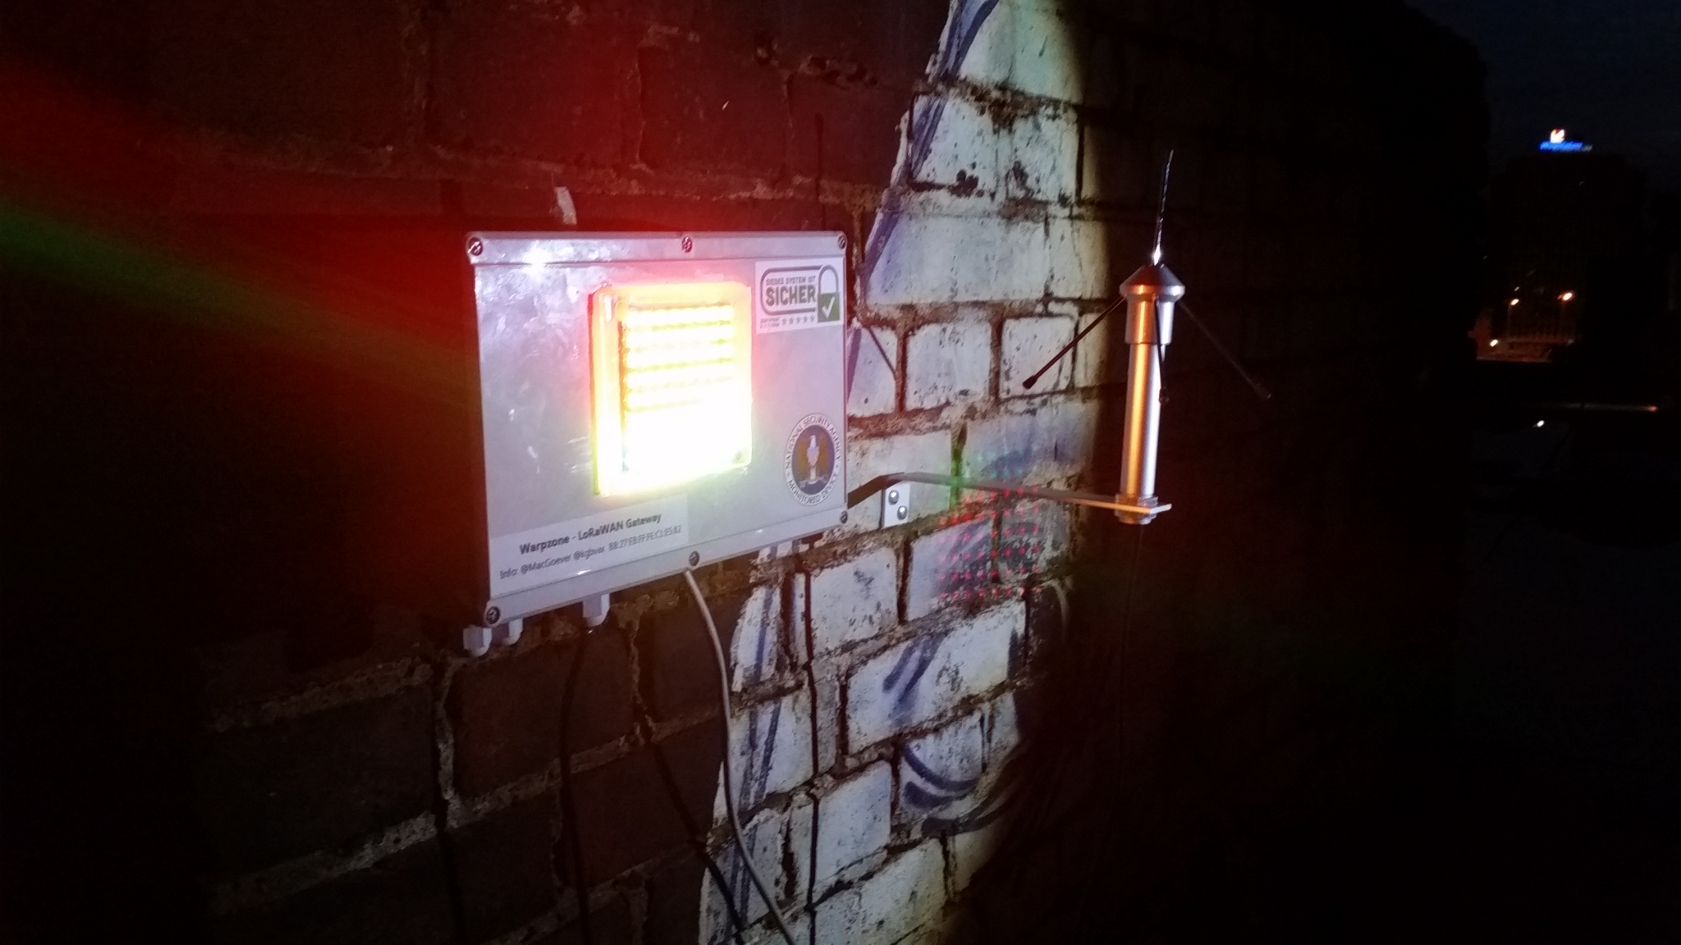
Bootstrap Münster
Notes:
Stumbled across LPWAN via SIGFOX
“I want this for everyone, without the NDA & license fee and as a community thing inside Freifunk”
Found TTN, build first gateway
Silly idea: „wiekaltistderkanal.de“
Done
Learned a lot. \o\ \o/ /o/

Slide 40
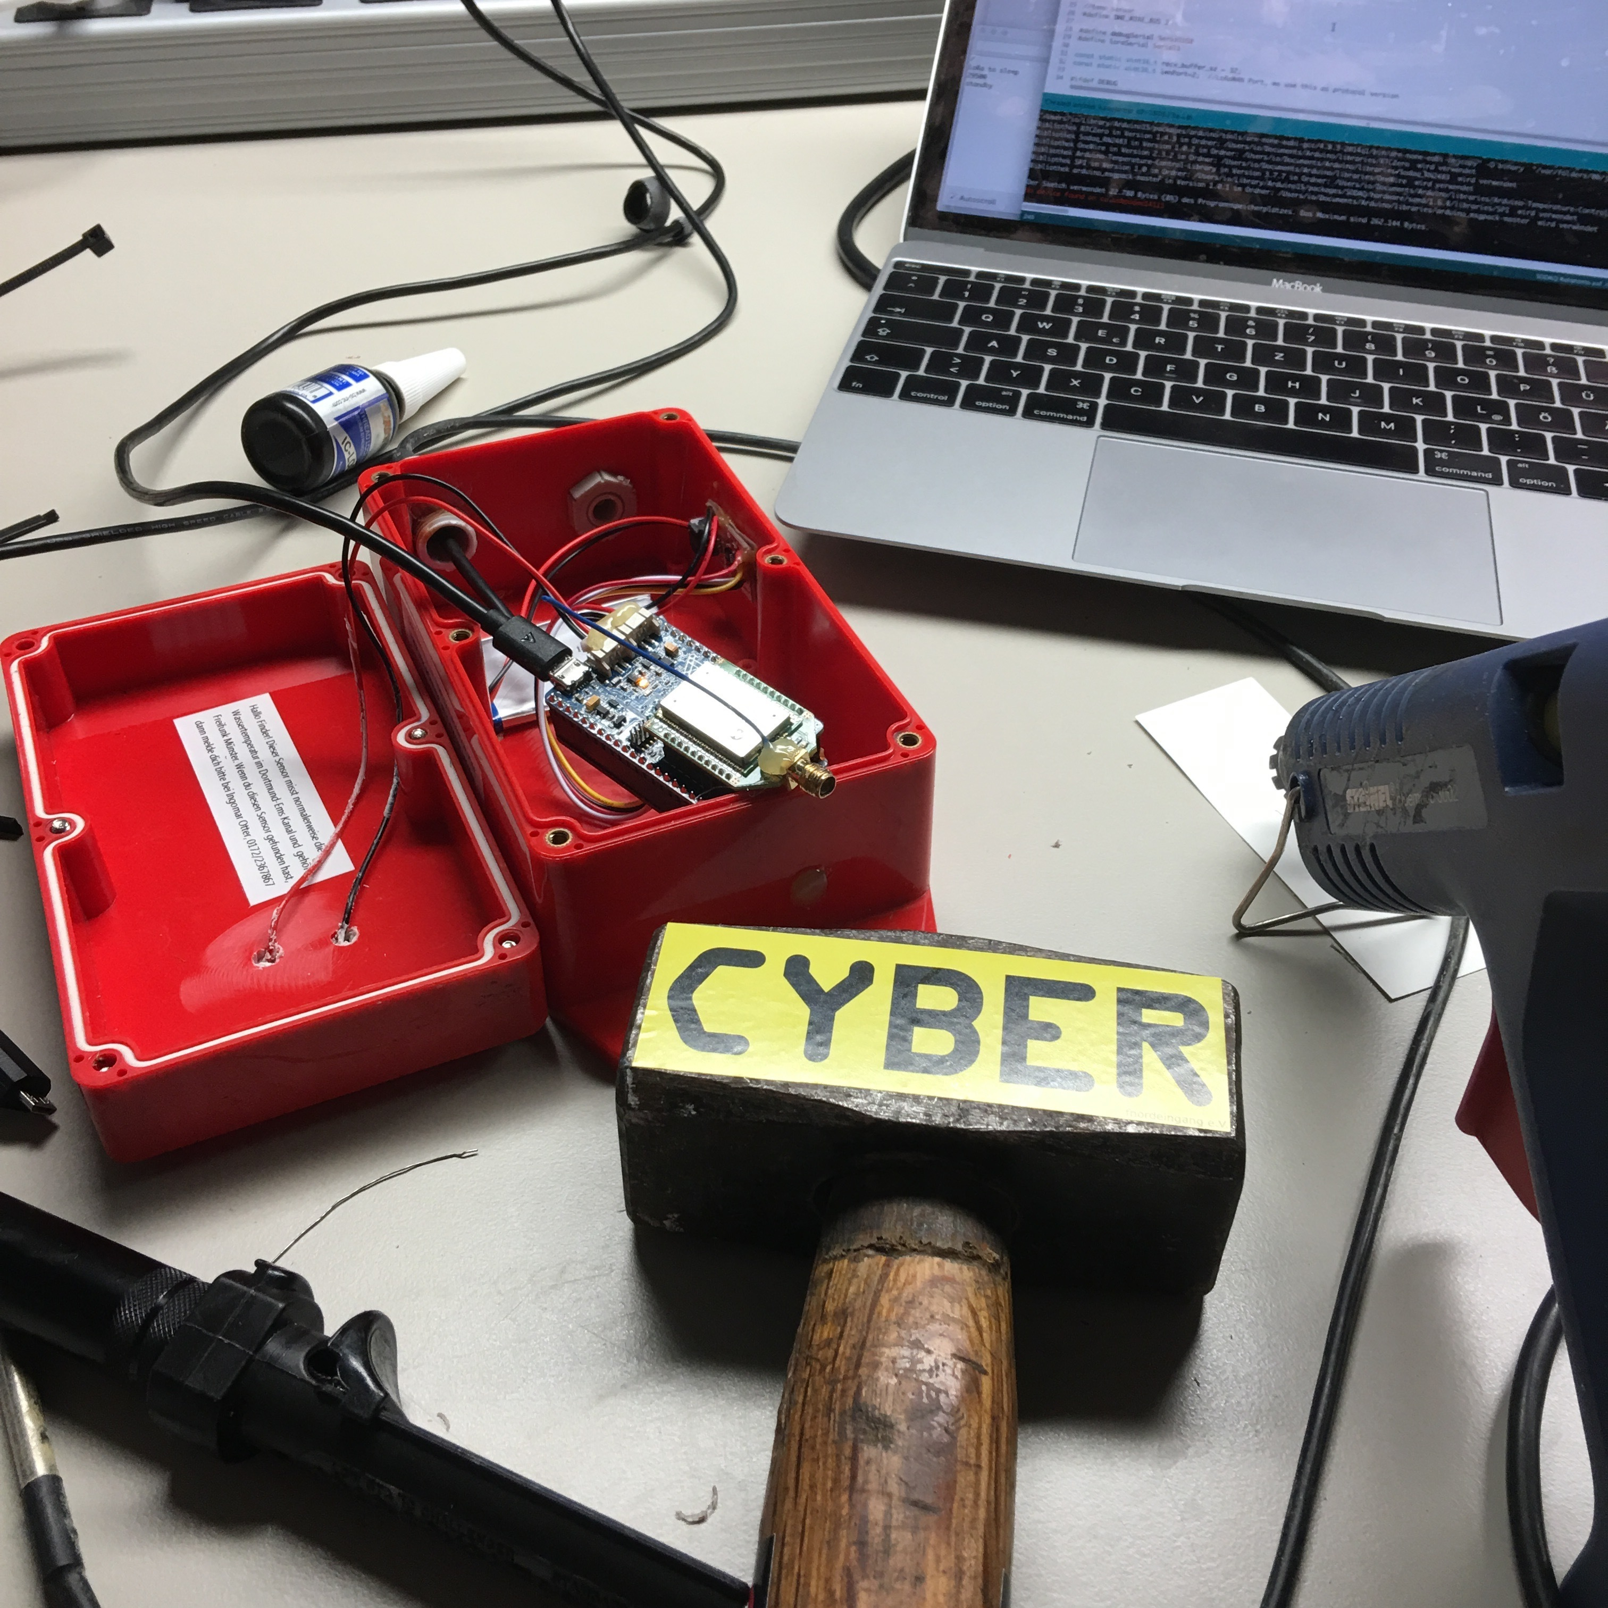
wiekaltistderkanal.de
wiekaltistderkanal.de

Slide 41
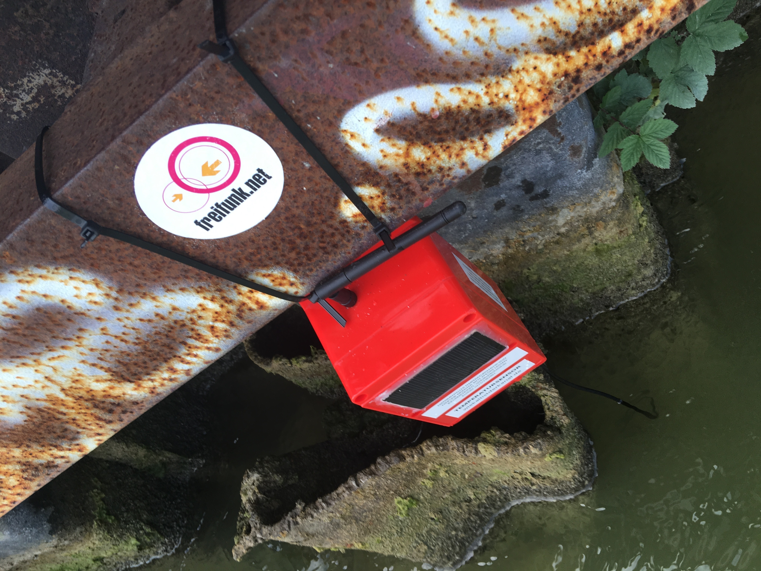

Slide 42
STOLEN!

Slide 43
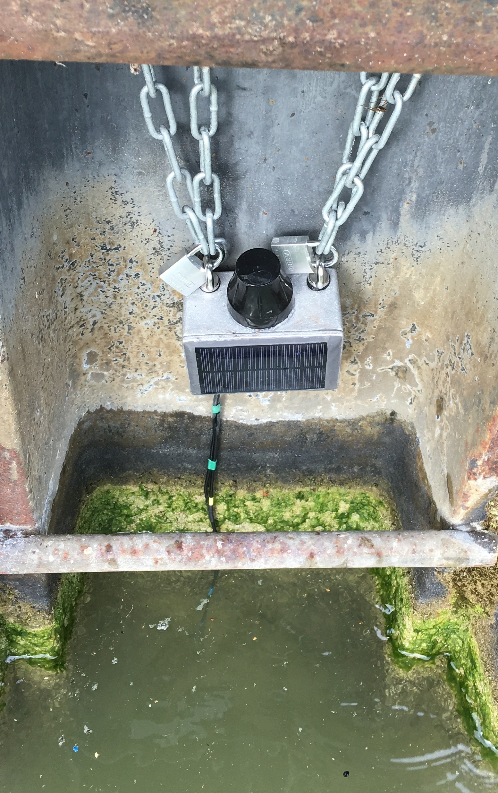
We're back!

Slide 44
Demo.
wiekaltistderkanal.de
Open Data on https://opensensemap.org.

Slide 45
Things we're working on
Detect & publish occupied e-car charging spots
Local river: Water level measurements (Use: Flood thread detection)
Misc. environmental sensors, together with sensebox.de

Slide 46
Summary: Living with Restrictions
Respect the Fair Use Policy!
Do not bend the rules - Rethink use cases.
How low can you go*?
*Look at TPL5110. 35nA

Slide 47
Links
Münster
wiekaltistderkanal.de
Forum Münsterland: https://forum.freifunk-muensterland.de/c/ffms-lp
Sensebox
Solar Prototyp: https://opensensemap.org/explore/57fb712811347b0011c10e80
The Things Network
https://www.thethingsnetwork.org
https://www.thethingsnetwork.org/wiki/Home
https://www.thethingsnetwork.org/forum/

Slide 48
vax@kgbvax.net
@kgbvax
License: CC BY-SA 4.0

